Slide 1
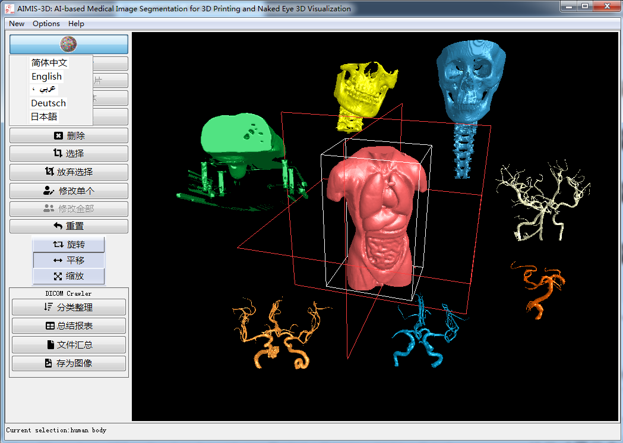
AIMIS-3D软件

Slide 2
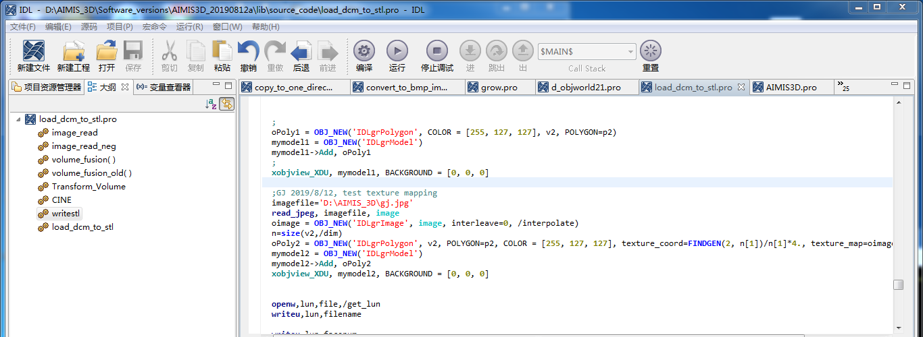
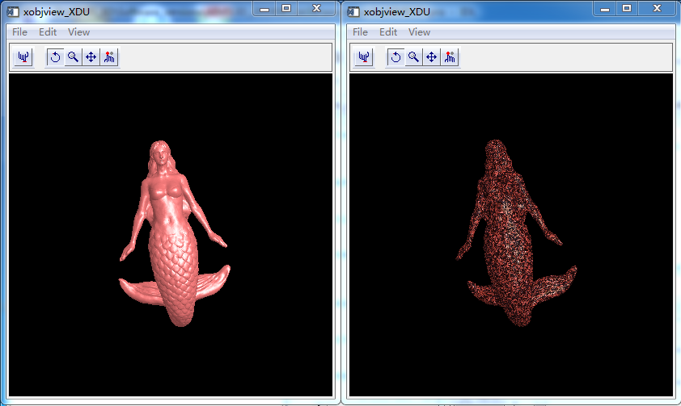
texture_map

Slide 3
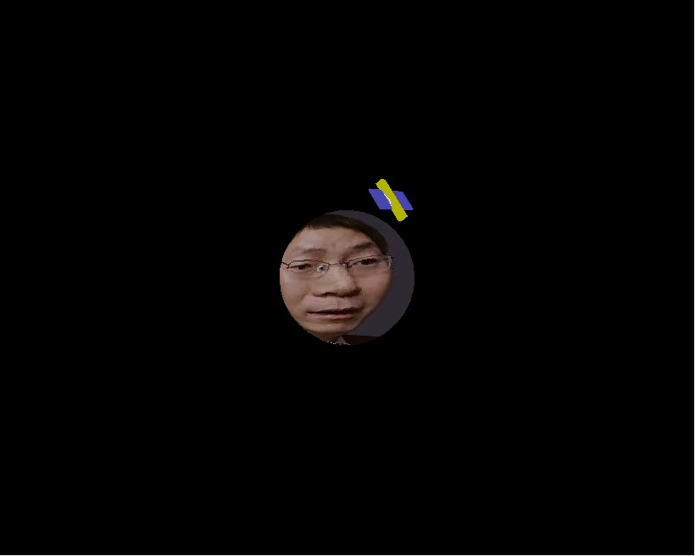
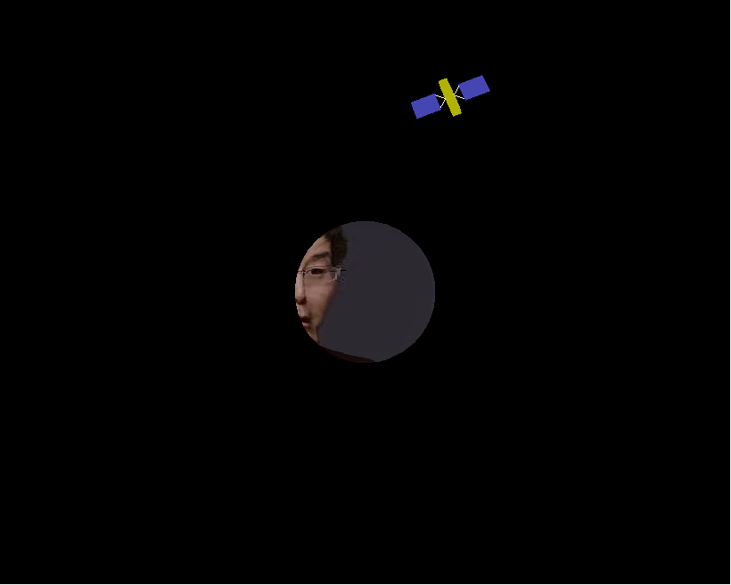
地图上拼图

Slide 4
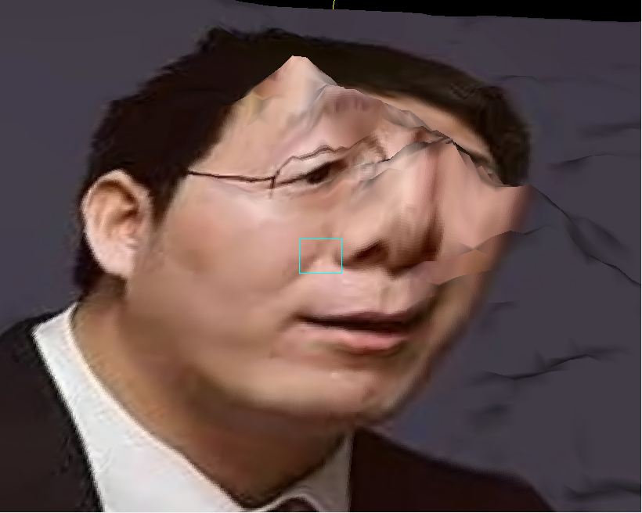
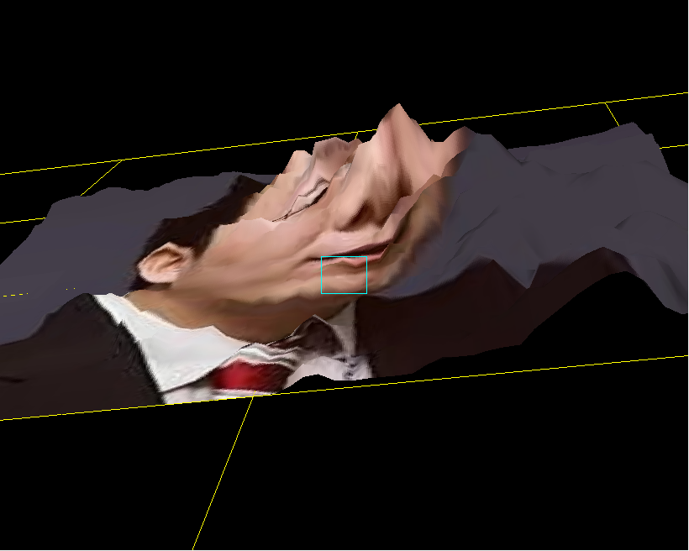
图片映射到一个表面

Slide 5
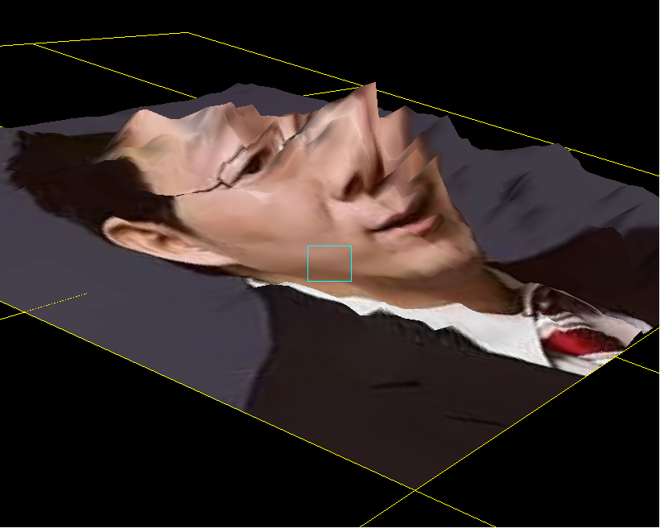
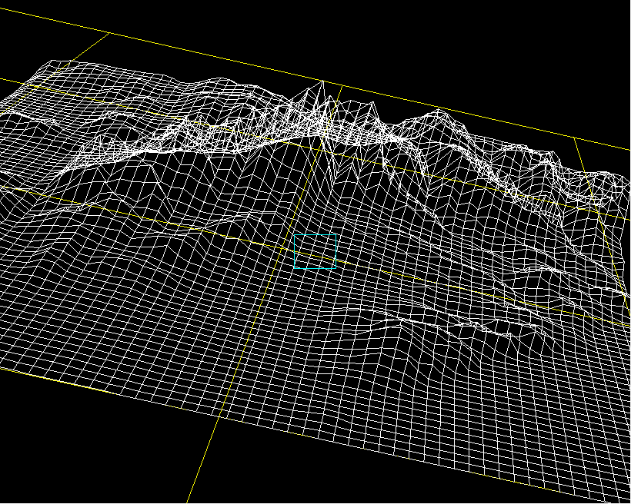
图片映射到一个表面

Slide 6
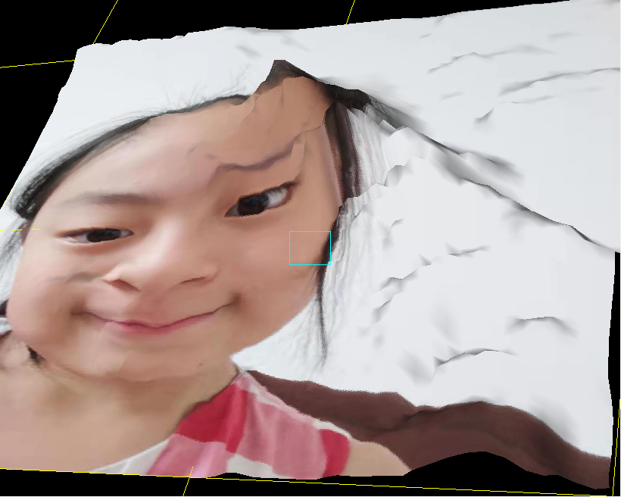
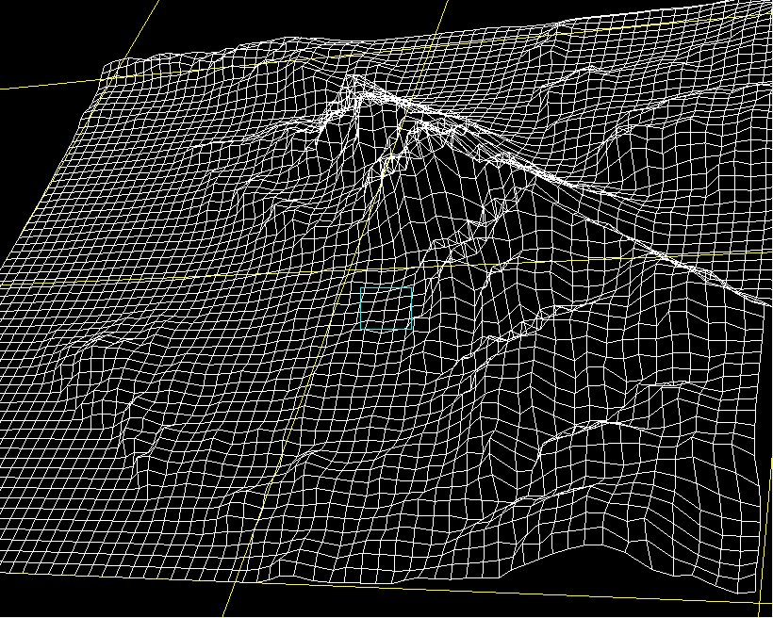

Slide 7
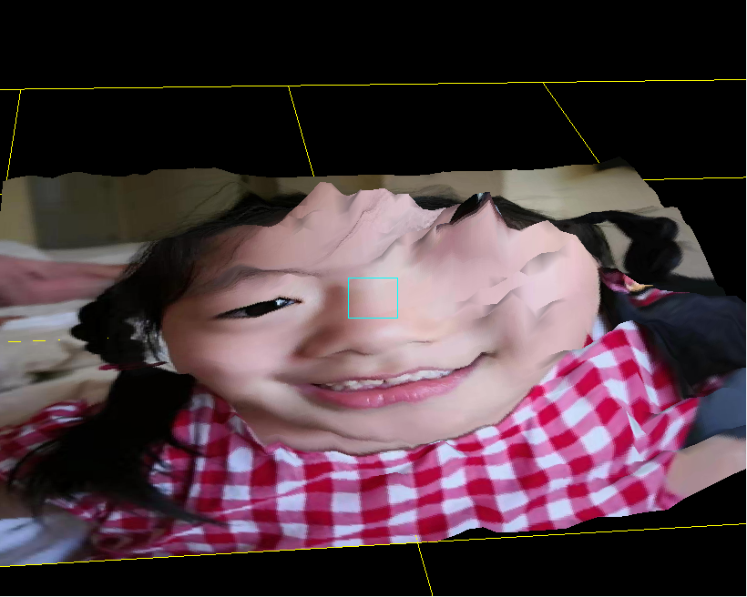
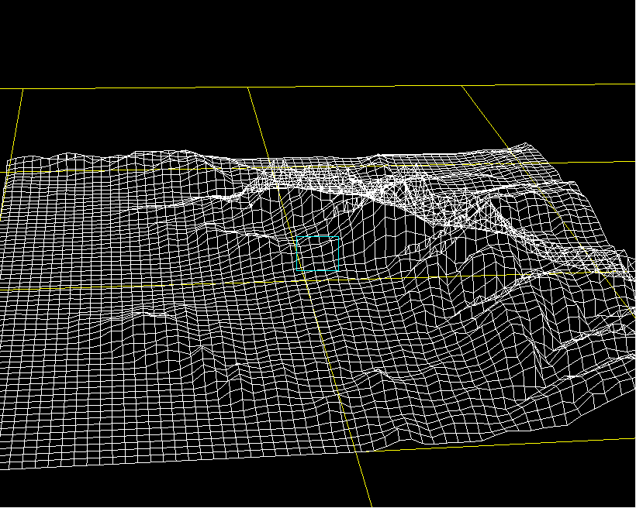

Slide 8
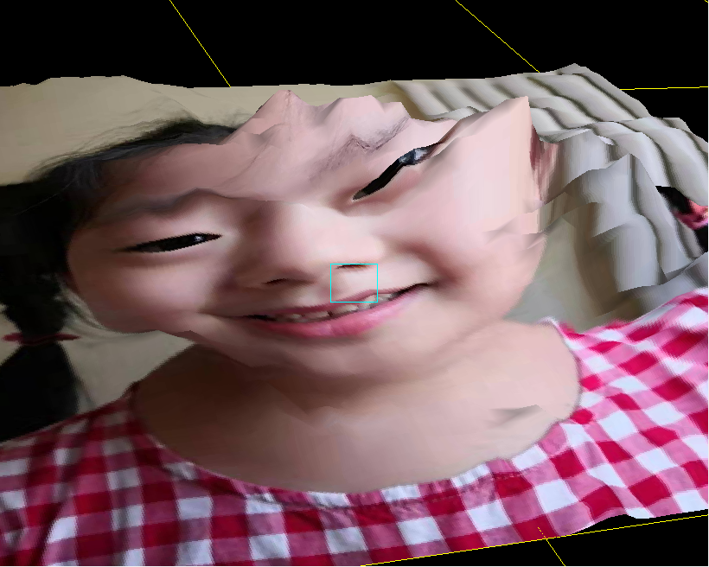
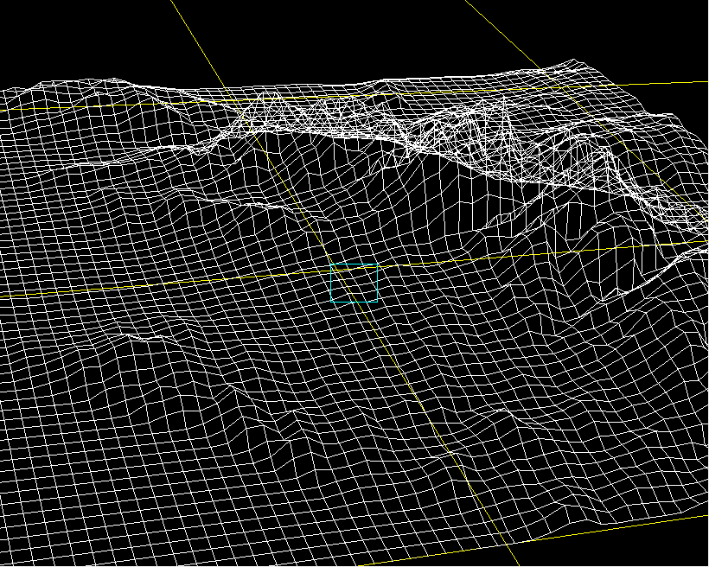

Slide 9
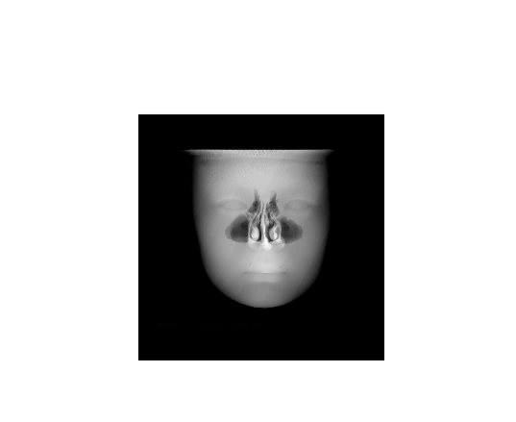
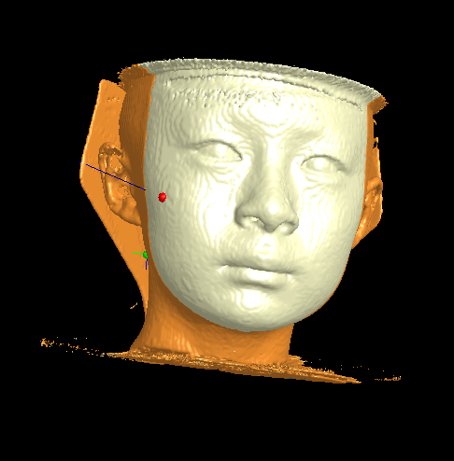

Slide 10
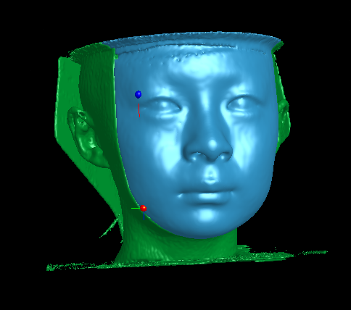
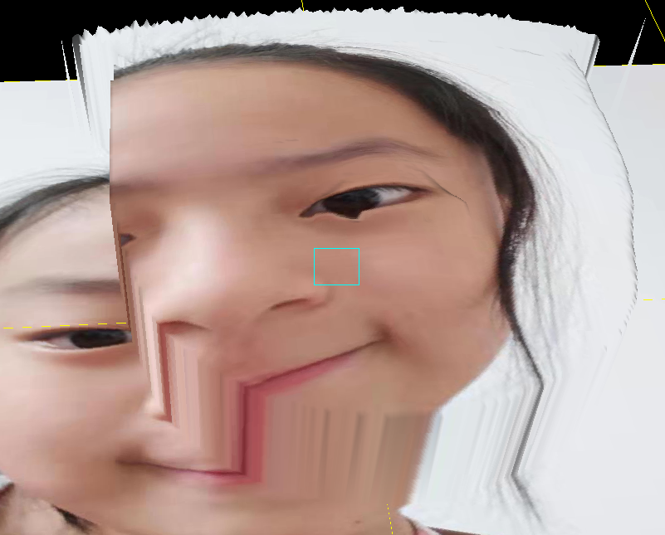
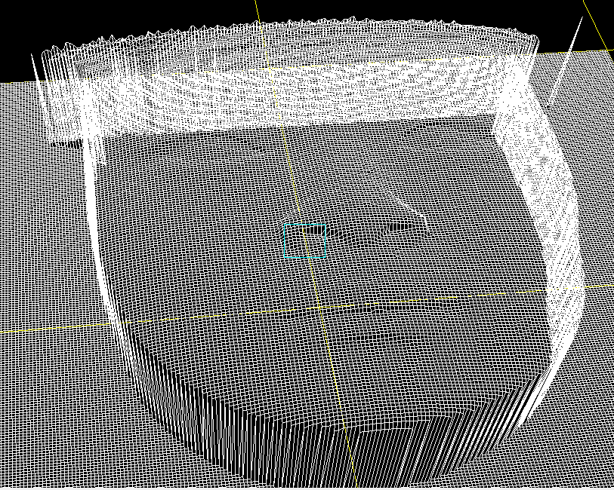

Slide 11
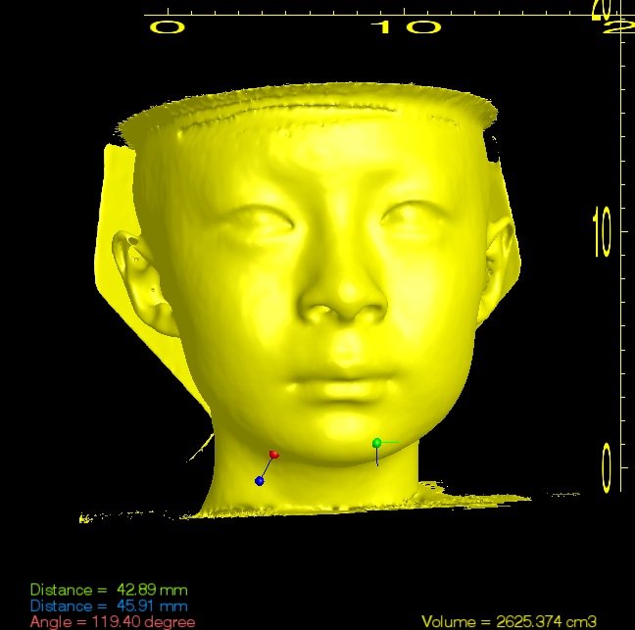
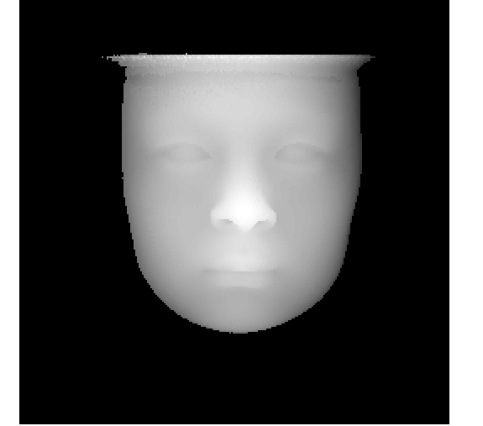
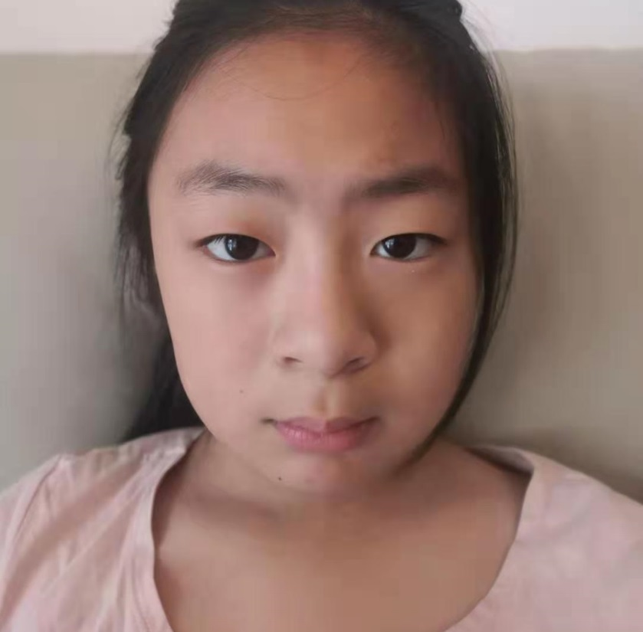
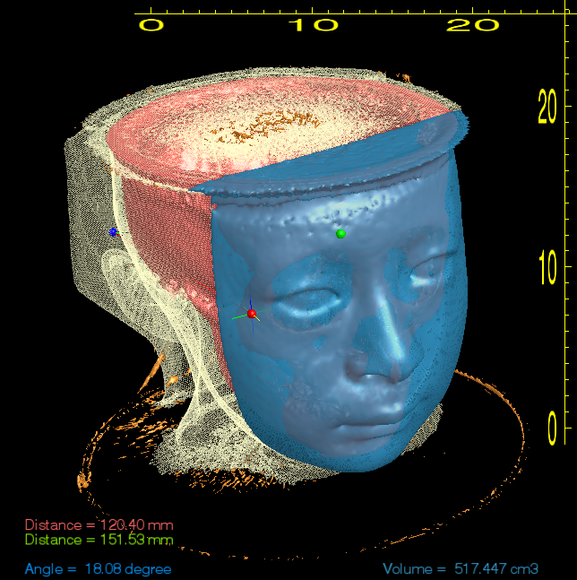
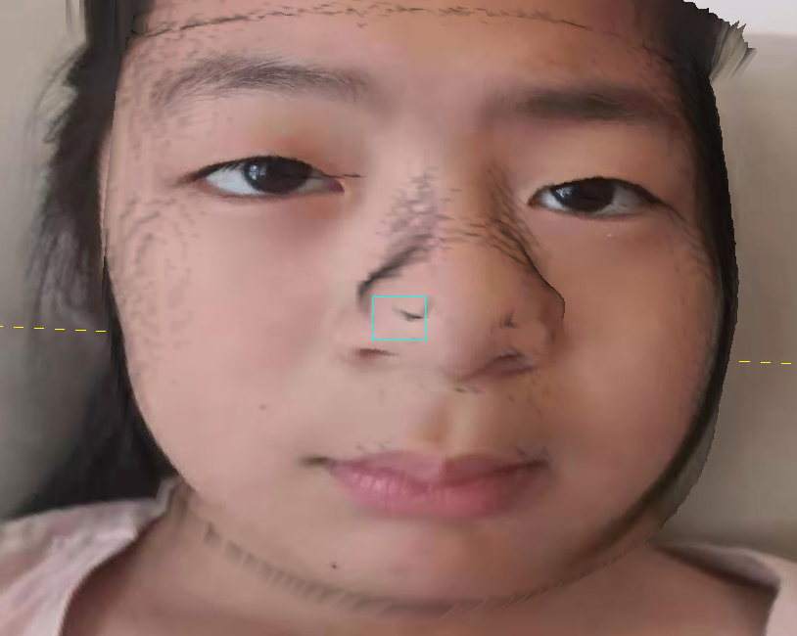
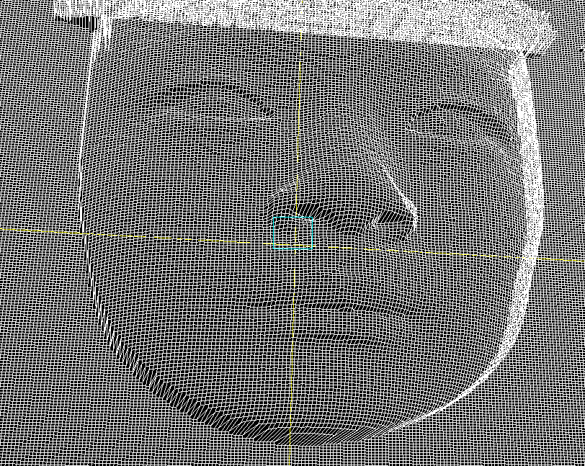

Slide 12
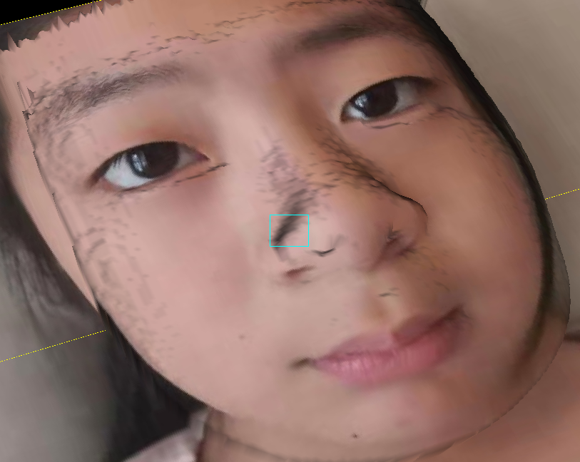
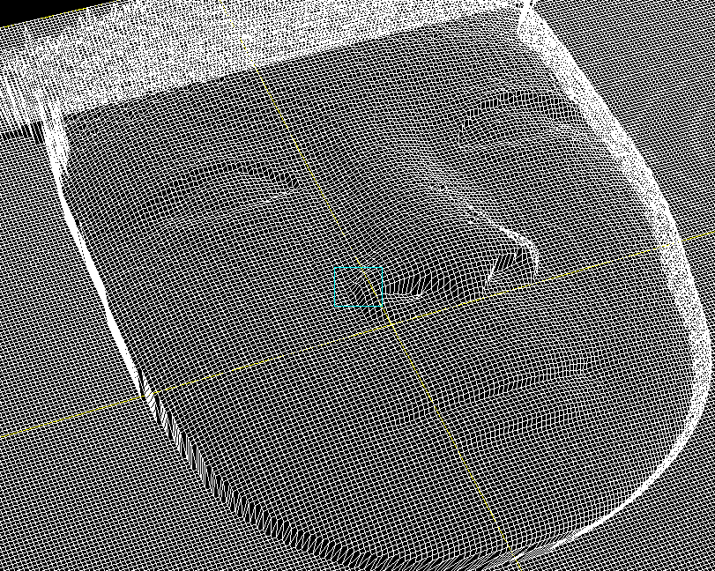

Slide 13
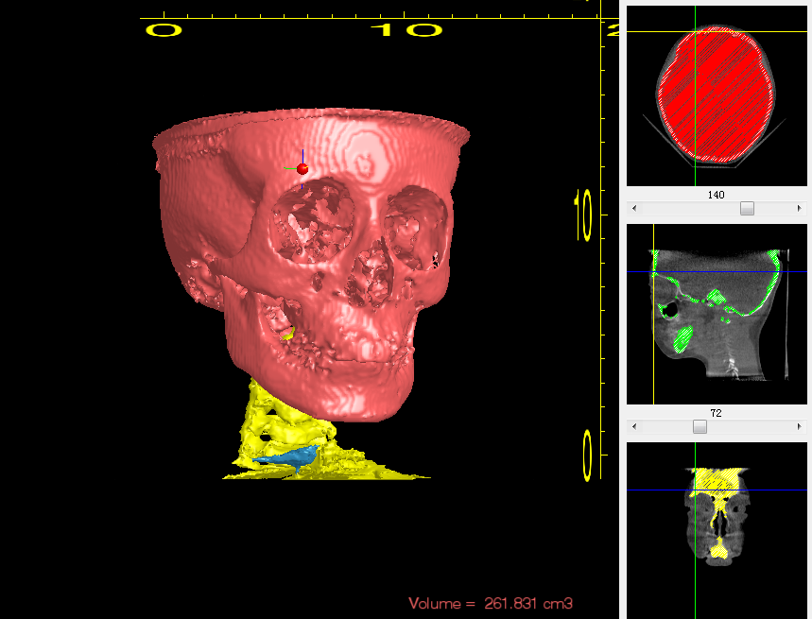

Slide 14
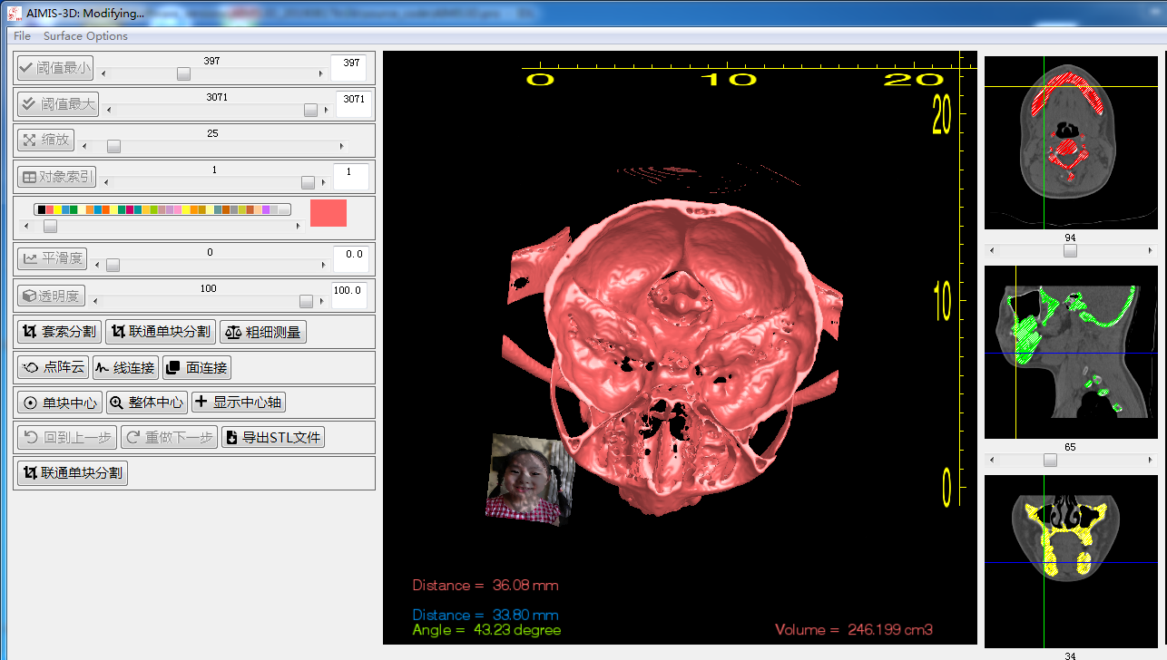

Slide 15
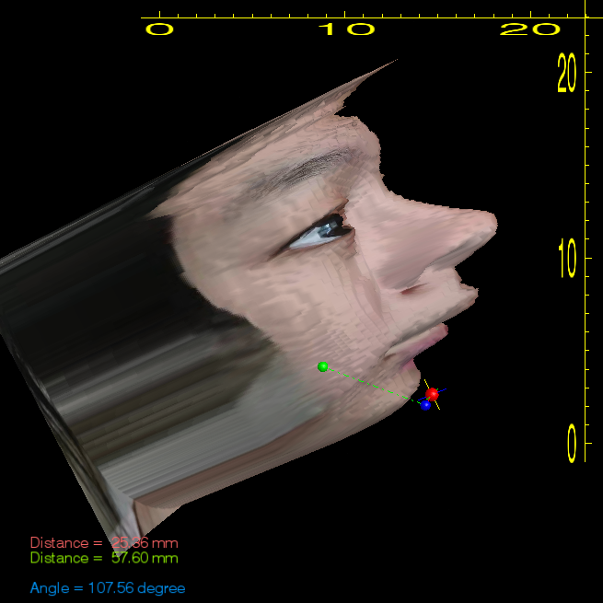
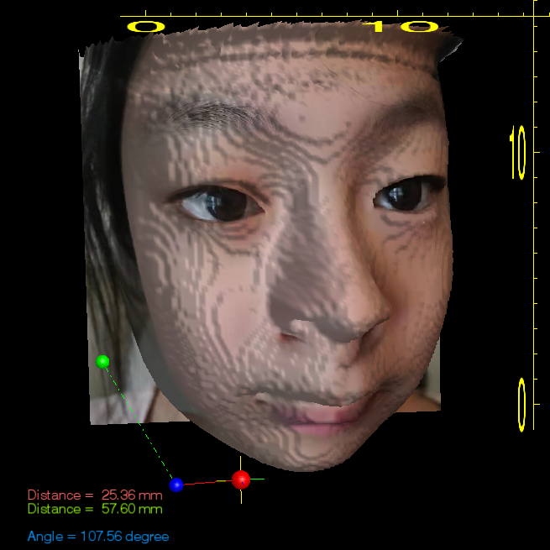
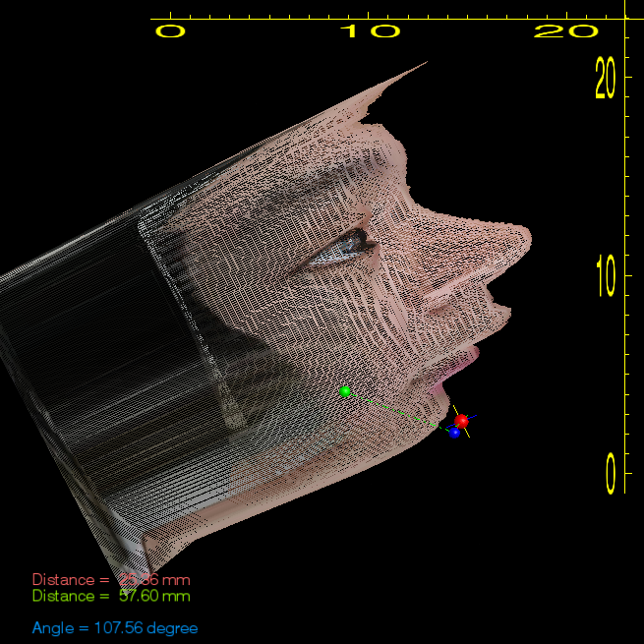
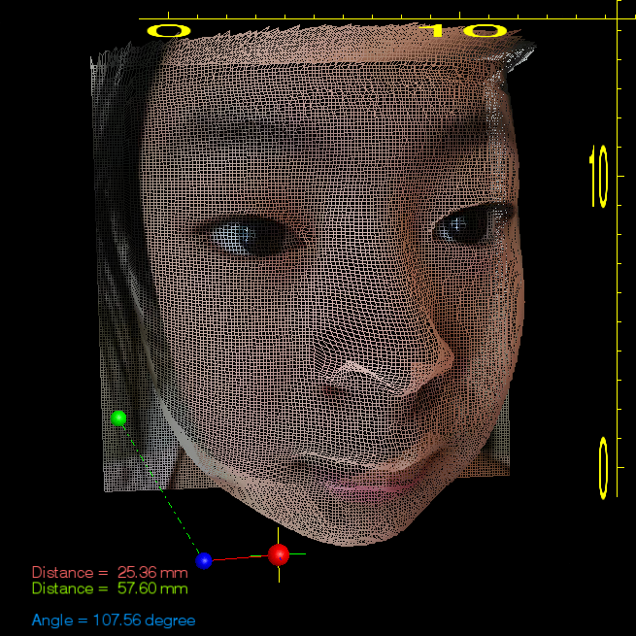

Slide 16
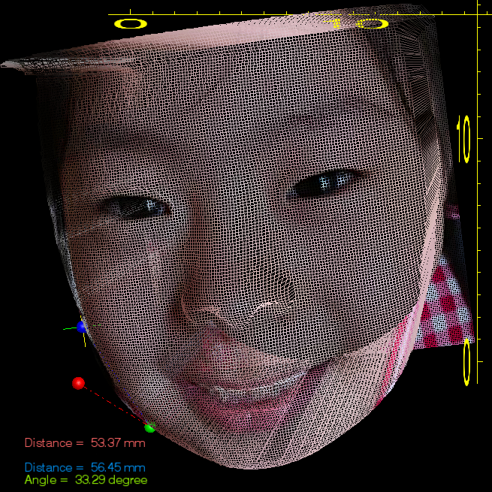
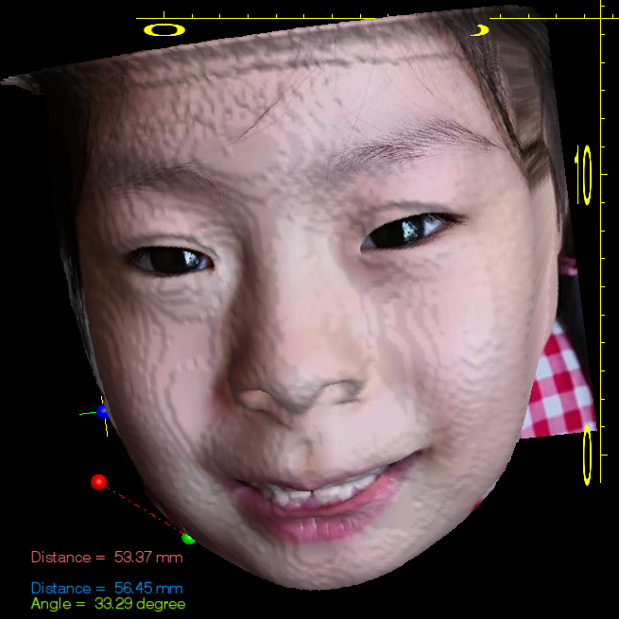

Slide 17
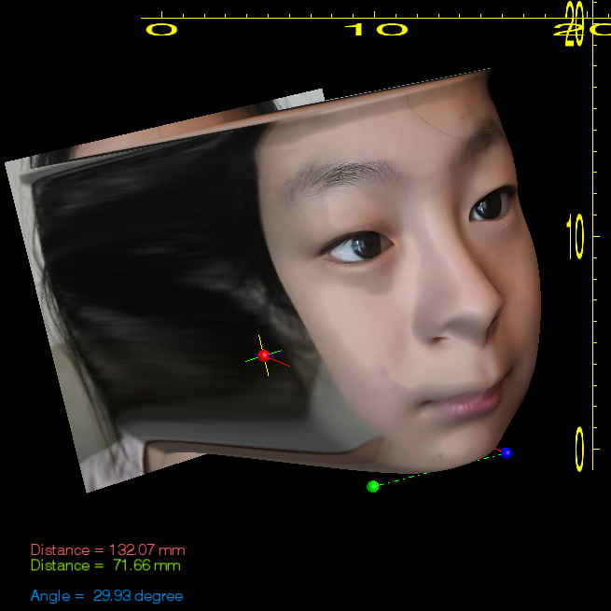
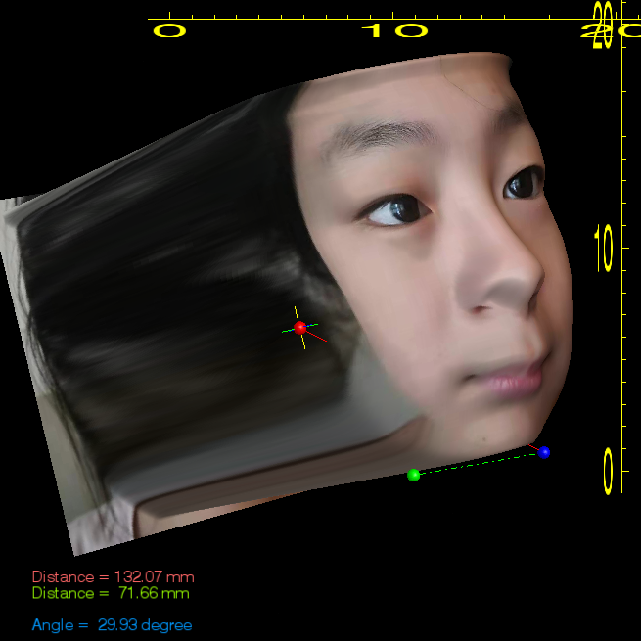
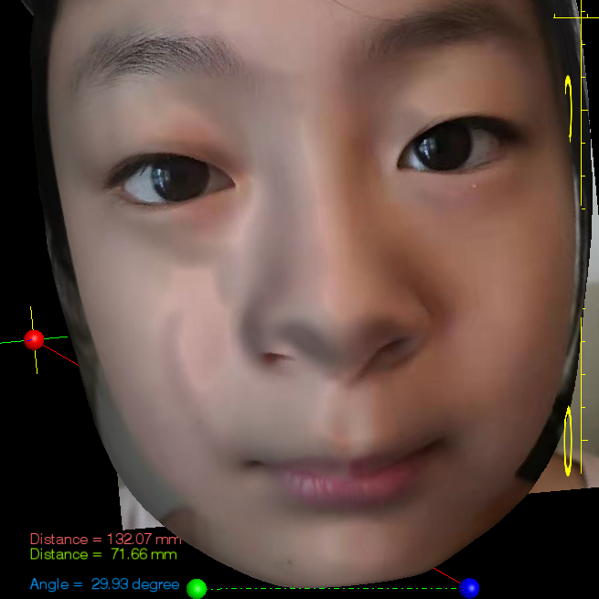
修正比例，瞳间距矫正，平滑图像

Slide 18

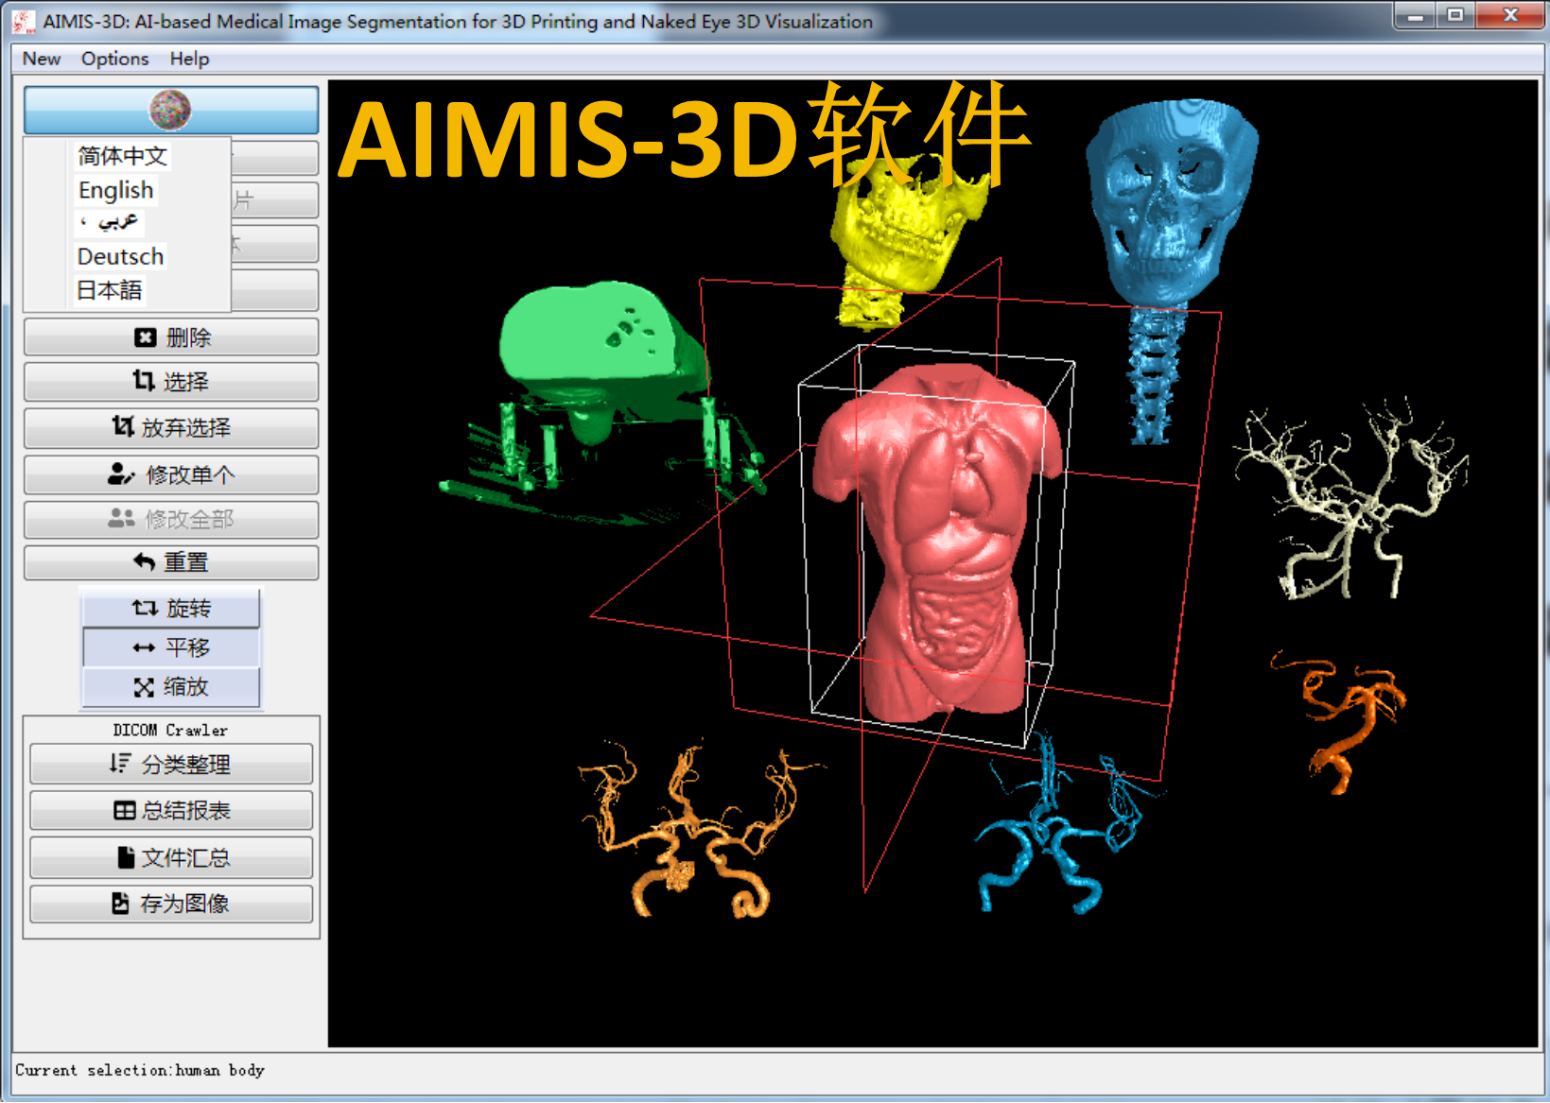

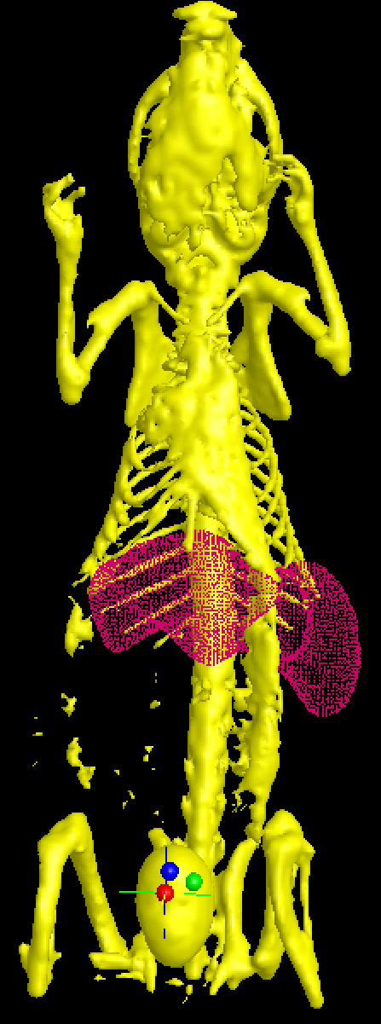
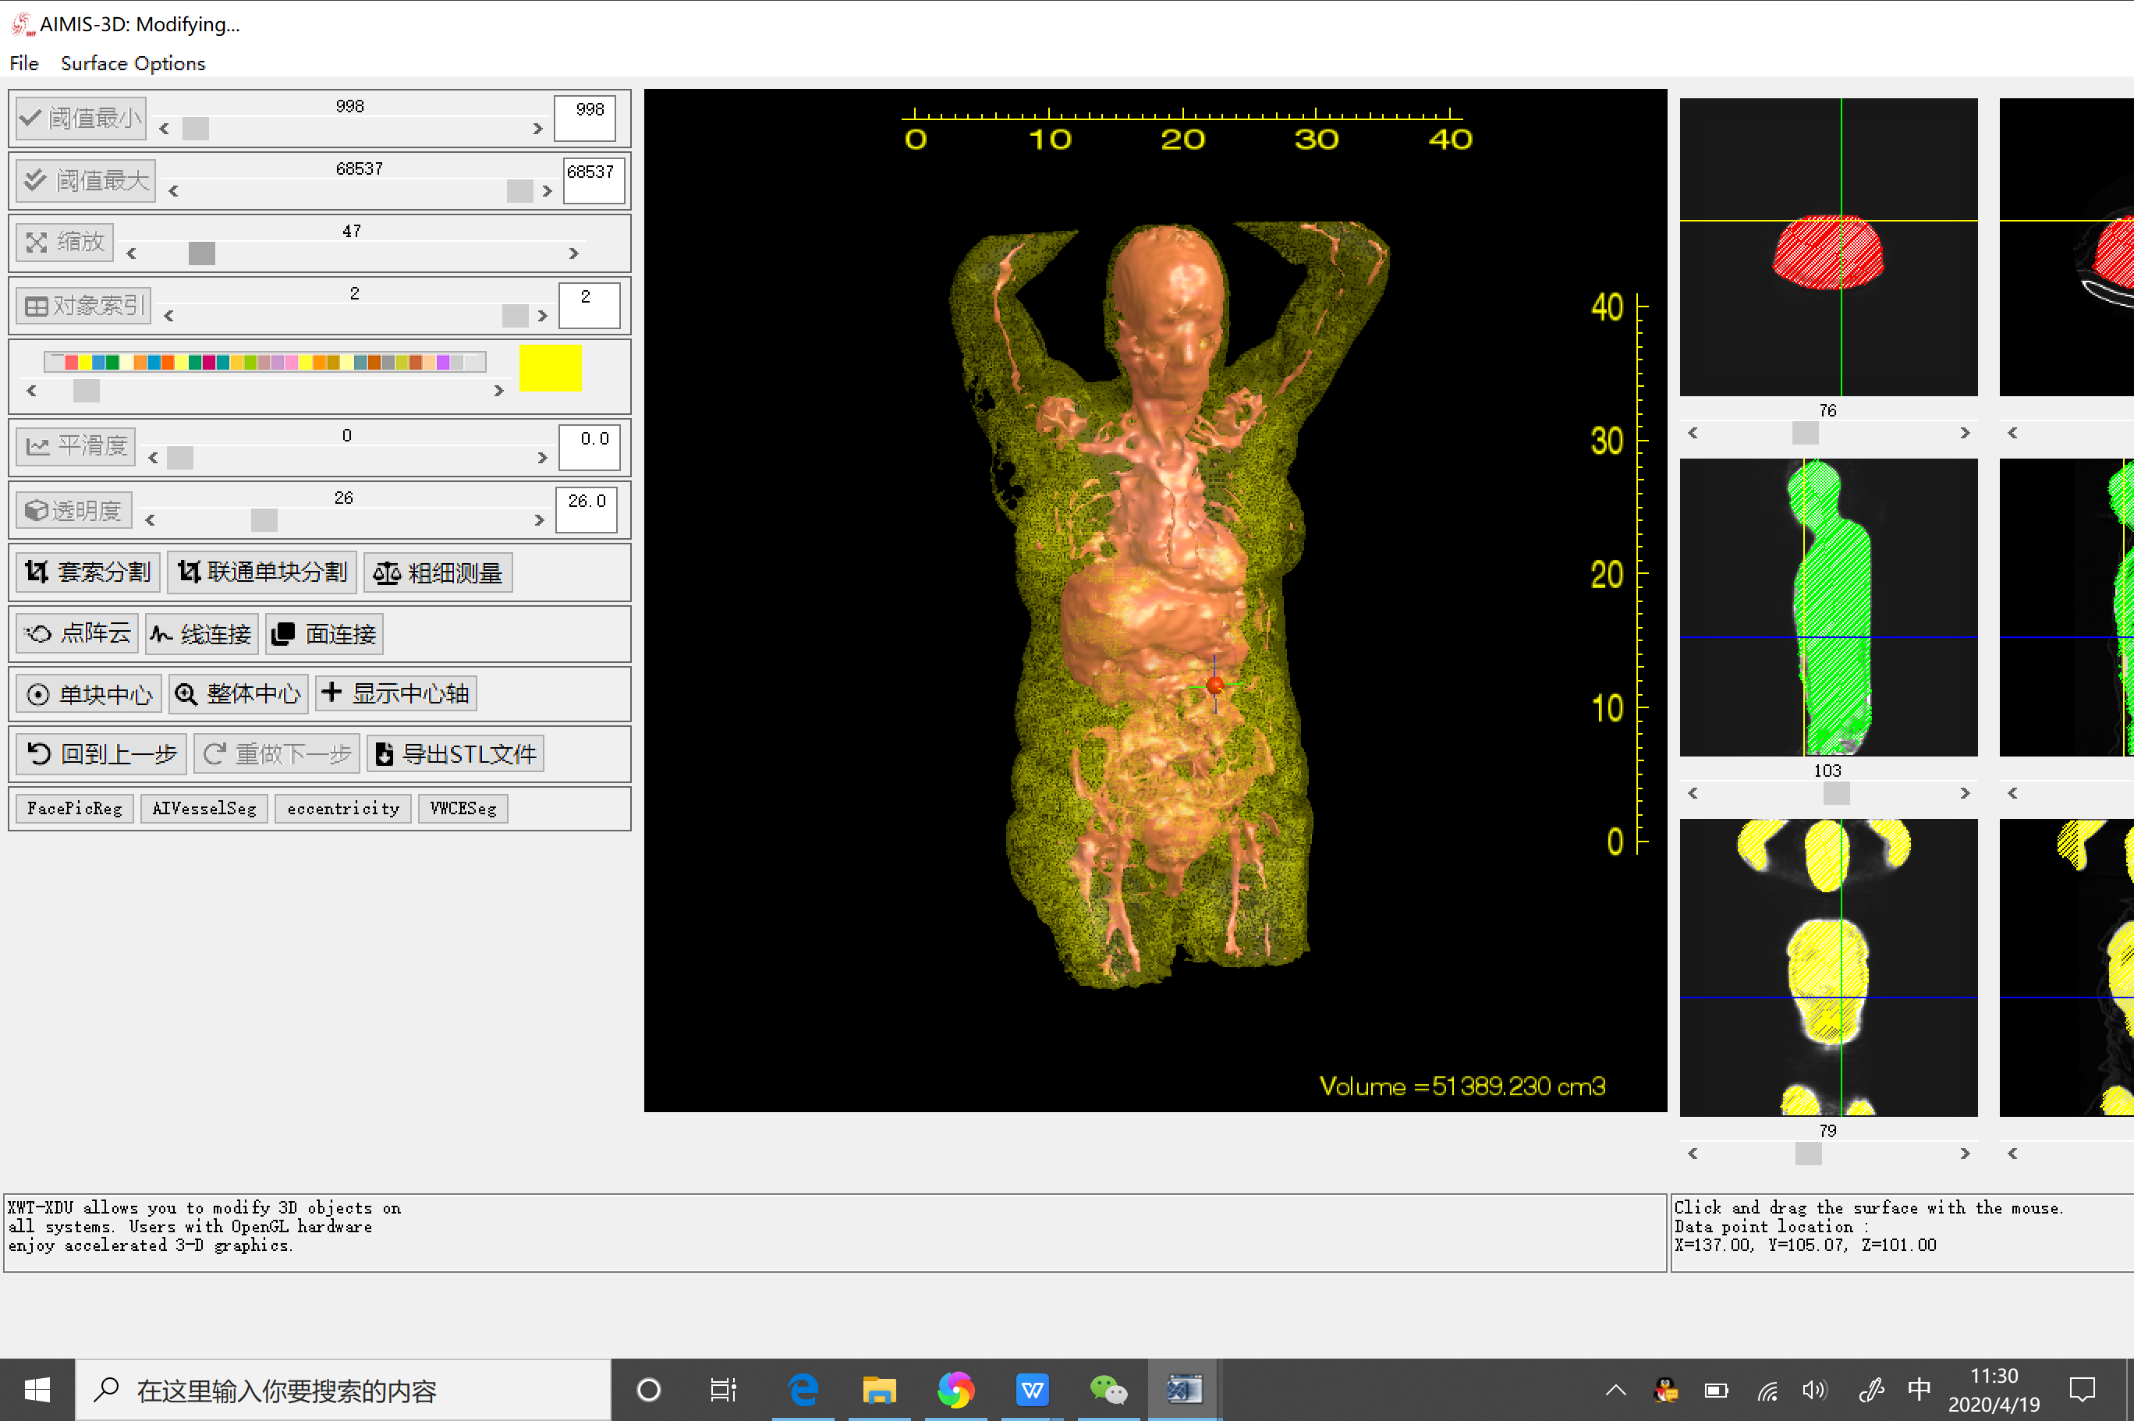
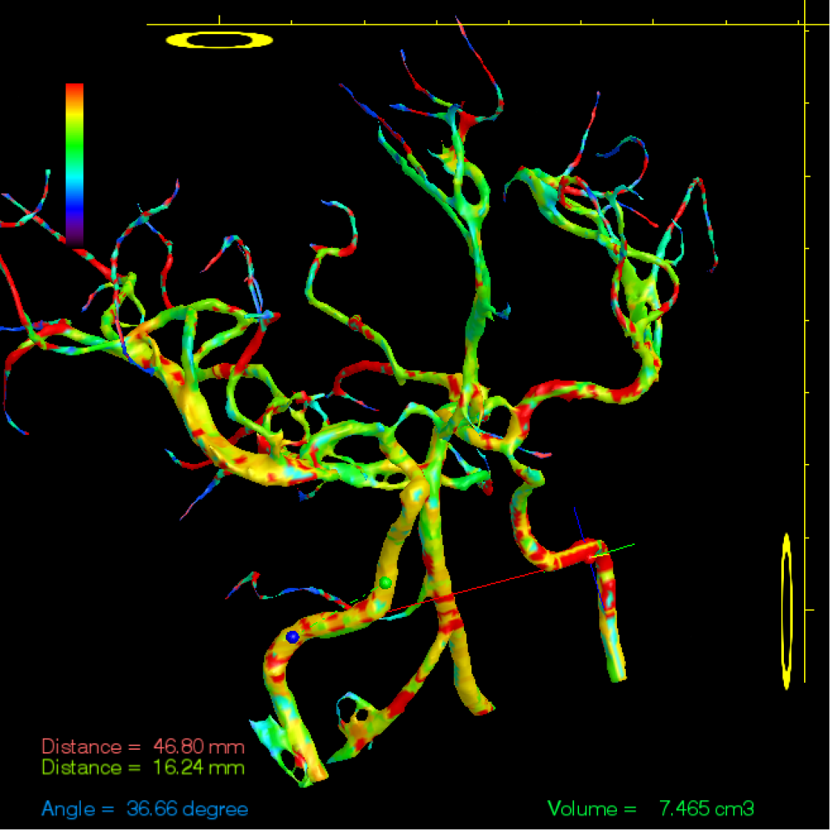

Slide 19






Slide 20
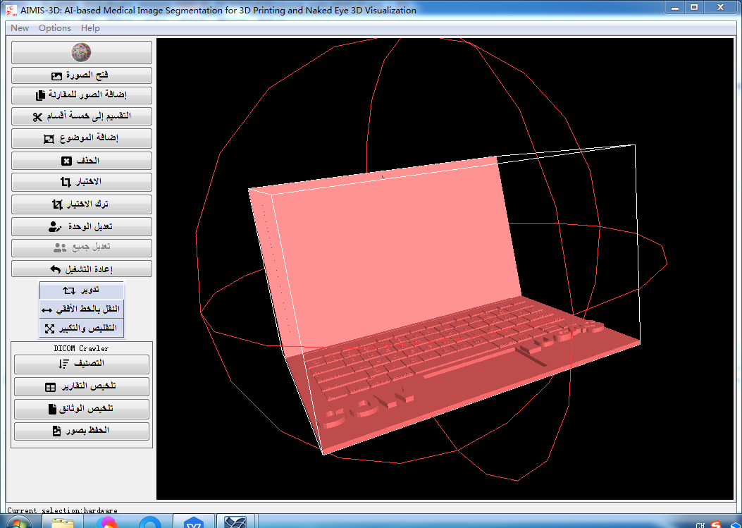
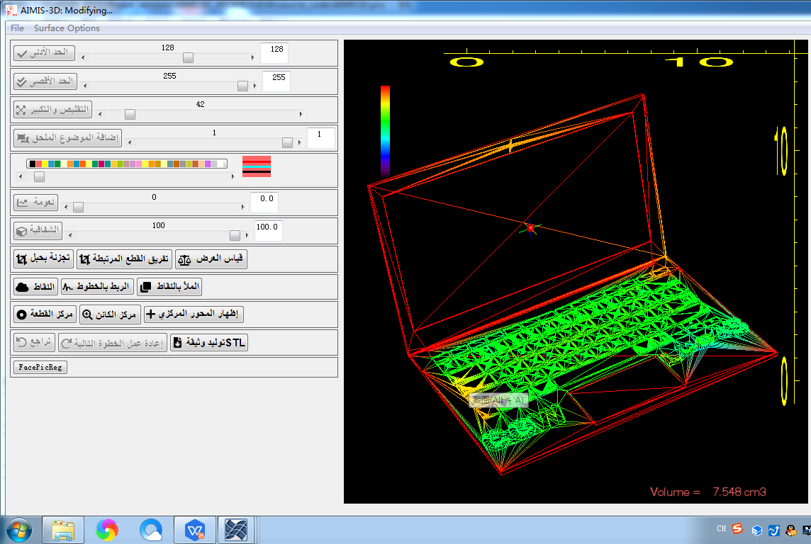

Slide 21
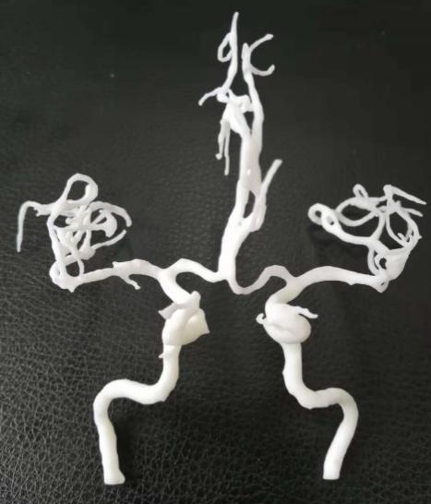

Slide 22
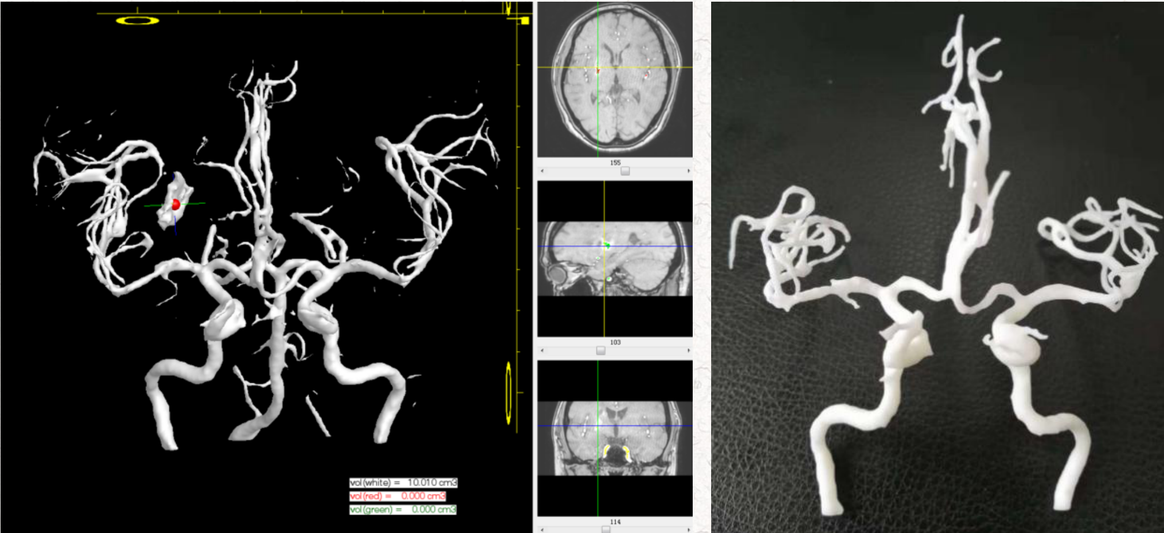

Slide 23
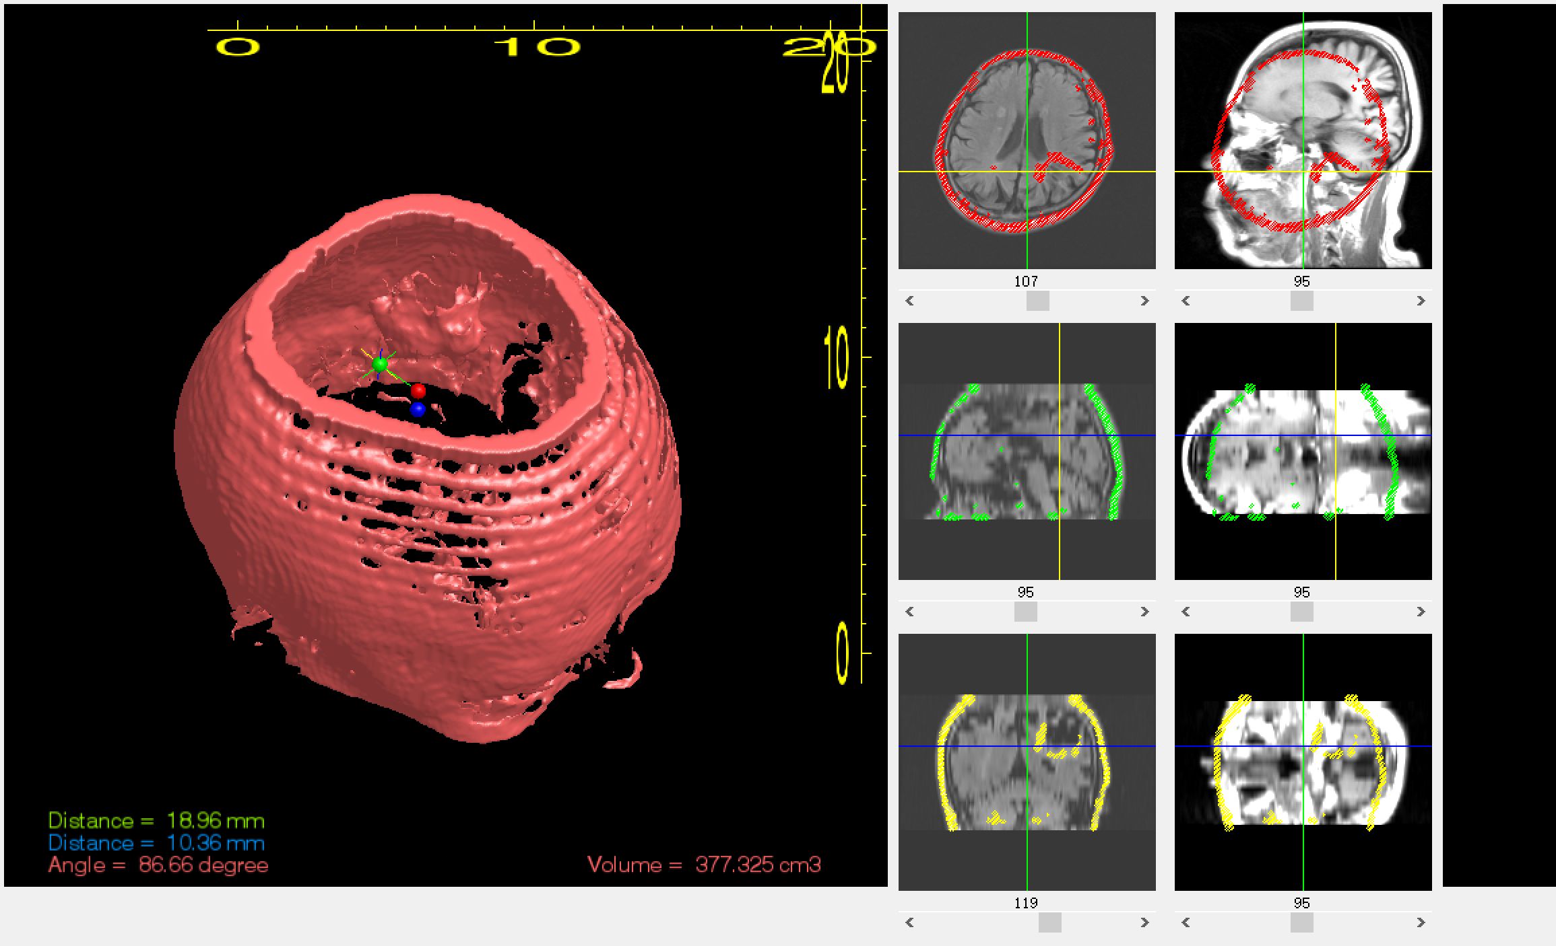
folder selection
folder = C:\D_drive\AIMIS_3D\images\BinzhouMC\ssz_20200409\Sorted\2426791_YAN_CHANG_SHU_20200330_head\S0005_112638_OAxT2Flair
folder = C:\D_drive\AIMIS_3D\images\BinzhouMC\ssz_20200409\Sorted\2426791_YAN_CHANG_SHU_20200330_head\S0007_113056_OSagT1Flair\

Slide 24
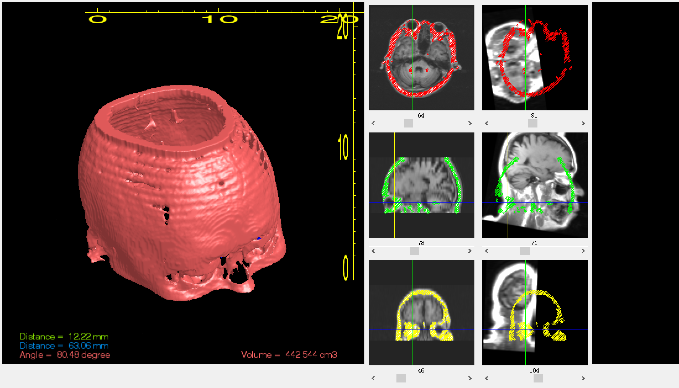
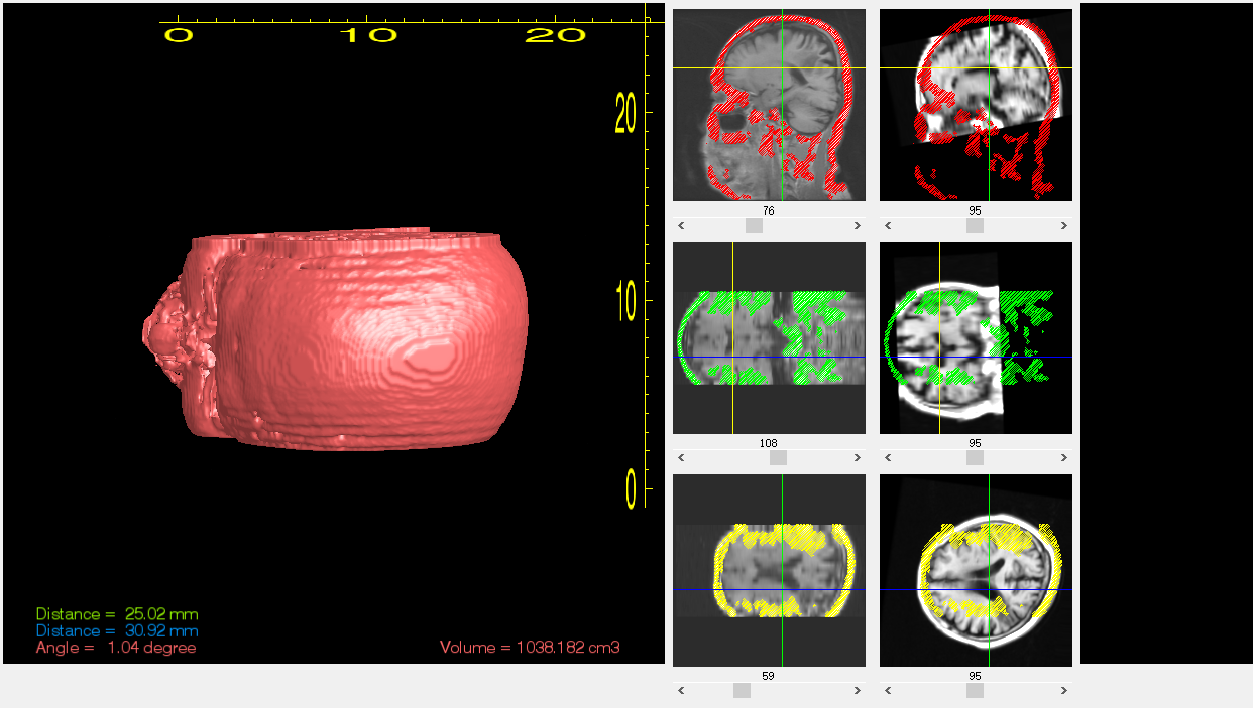
1st center loc = 18.237811
-2.3627030
16.827643
2nd center loc = 6.6158754
-21.417408
-22.025312
1st center loc = 6.6158754
-21.417408
-22.025312
2nd center loc = 18.237811
-2.3627030
16.827643
folder = C:\D_drive\AIMIS_3D\images\BinzhouMC\ssz_20200409\Sorted\2426791_YAN_CHANG_SHU_20200330_head\S0006_112929_OAxT1Flair
folder = C:\D_drive\AIMIS_3D\images\BinzhouMC\ssz_20200409\Sorted\2426791_YAN_CHANG_SHU_20200330_head\S0007_113056_OSagT1Flair\
folder = C:\D_drive\AIMIS_3D\images\BinzhouMC\ssz_20200409\Sorted\2426791_YAN_CHANG_SHU_20200330_head\S0007_113056_OSagT1Flair
folder = C:\D_drive\AIMIS_3D\images\BinzhouMC\ssz_20200409\Sorted\2426791_YAN_CHANG_SHU_20200330_head\S0006_112929_OAxT1Flair\

Slide 25

2021、2、21

